Slide 1
Lattice Parameter Changes of Binary Alloys
CME 502 Final Presentation
Melanie Brito

Slide 2
Table of contents
01
02
03
04
Background
Goals
Bulk and Shear Moduli
Composition Effects
05
08
Grain Size Effects
Curve Fitting
Intro to the FeMg system
Goal of the Python Code
06
07
Grain Boundary Segregation
Plotting

Slide 3
01
Background
Introduction to the FeMg system

Slide 4
Fe Mg ODS Alloys
PI: Dr. Jason Trelewicz
Project: Mechanical Ball Milling of Iron Magnesium powders to make ODS alloys
Goal: To make an oxide dispersion strengthened (ODS) alloy of Fe and Mg.
What is an ODS alloy?
When 2 powders are milled together, the solute phase becomes dispersed and upon annealing, forms oxide deposits throughout the material.
Beneficial because gives the alloy enhanced properties at elevated temperatures.
Ideal for fusion reactors.
ODS alloys successfully made for many systems but rarely for FeMg due to problems with Fe oxidation.

Slide 5
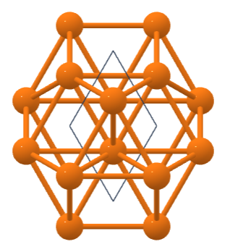
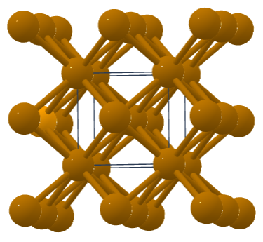
Fe Mg Milling
HCP Mg
Experimental: Different compositions of FexMg alloys milled at the same conditions.
x represents 0.01, 0.05, 0.10, 0.15, 0.20 at% Mg
PM 100 Ball Mill (500 RPM, 10 hours, 3.5wt% ethanol PCA)
Fe Mg solid solution is made where BCC Mg becomes incorporated into the BCC Fe lattice.
Mg usually HCP lattice stable but shifts to BCC.
Some Mg segregates to the grain boundaries.
It is desired to know the extent of this process/ how much Mg is in the grain boundaries.
BCC Mg
Materials Project
Notes:
https://materialsproject.org/materials/mp-153
https://materialsproject.org/materials/mp-13

Slide 6
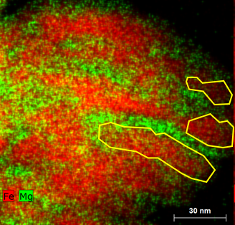
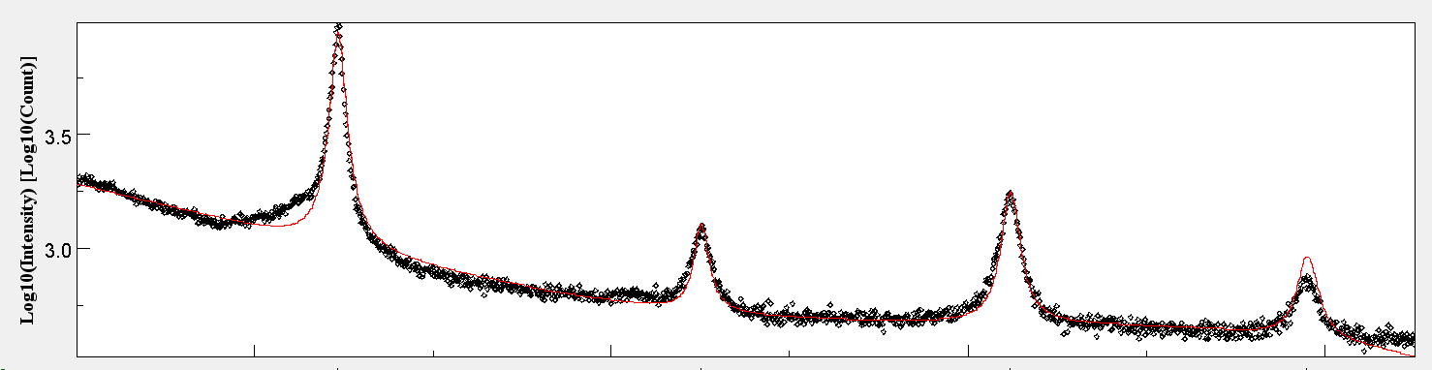
Fe Mg Properties
XRD patterns of the different samples were taken and Reitveld Refinements used to get Lattice Parameter and Grain Size.
Mg segregation to the grain boundary causes changes in the lattice parameter from BCC Fe literature value.
Increasing changes as composition changes.
TEM Image of Fe15Mg powder
XRD Pattern Refinement (Fe15Mg)

Slide 7
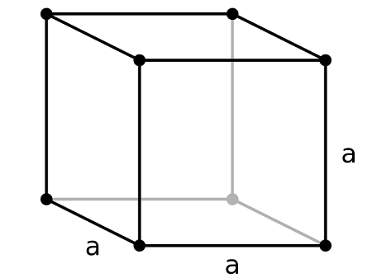
Lattice Parameter Changes
Want to determine what physical phenomena cause lattice parameter shifts and to what extent.
Changes can be broken down into several effects
Compositional Effects
Mg compositons change LP
Grain Size Effects
Milling changes grain size → changes LP
Grain Boundary Segregation
Amount of Mg in GB → changes LP
Crystal Structure Overview
Notes:
https://study.com/learn/lesson/cubic-unit-cell-lattice-parameter-crystal-structure.html

Slide 8
02
Goals
Goal of the Python Code

Slide 9
Lattice Parameter Calculations
There are detailed equations to calculate the LP changes due to each one of the effects.
Many parts of the equations need to be changed for each of the different compositions and this can be time consuming and leave room for errors and typos.
Solution: Use loops and arrays to manipulate the equations to get the lattice parameter changes for each of the compositions
Each one of the compositions will have
Δa_{comp} ,Δa_{GS} , Δa_{GBS} (lattice parameter changes)
a_{lit}, a_{exp} (literature and experimental LP)

Slide 10


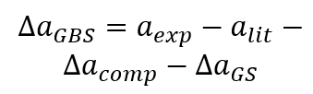

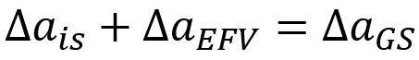
Lattice Parameter Calculations
Composition Effects
Grain Size Effects
Grain Boundary Segregation
Lubarda et al.
Rane et al.

Slide 11
Plotting and Curve Fitting
Plot of Lattice Parameter (A) vs Composition (at% Mg) made to compare the effects
Experimental
Vegard’s Law
Composition Effects
Grain Size Effects
Grain Boundary Segregation
Curve fitting will be used on the experimental data to get an equation for lattice parameter as a function of composition.
Linear Regression Model will be used for the curve fitting (linregress)
Curvefit function will also be used (linear fit, 2nd order, 3rd order)
Notes:
https://materialsproject.org/materials/mp-153
https://materialsproject.org/materials/mp-13

Slide 12
03
Effective Bulk and Shear Moduli

Slide 13


Effective Bulk and Shear Modulus
Formulas for effective shear modulus uses bulk and shear moduli for each of the pure components (BCC Fe and BCC Mg).
Values obtained from literature (Lubarda et al.)
Solve for the value of shear modulus (μ) and use this to solve for bulk modulus (k)
Must be repeated for each composition (x)
All values in GPa.
Lubarda et al.

Slide 14
Outline of Code
For loop over compositons (x)
Make arrays for the bulk and shear moduli for the pure components (kpure, upure) and different Mg compositions (x)
Pre-allocate arrays for effective moduli (eu, ek)
Define functions for the equations for effective moduli (efshear, efbulk)
Plug potential shear modulus values (start with 50 GPa) into the function (efshear) and when output changes from positive to negative (μ goes through 0) save the μ value and break the loop.
While loop that runs over potential values of μ
Find the effective bulk modulus (K)
Save effective moduli values to a text file

Slide 15
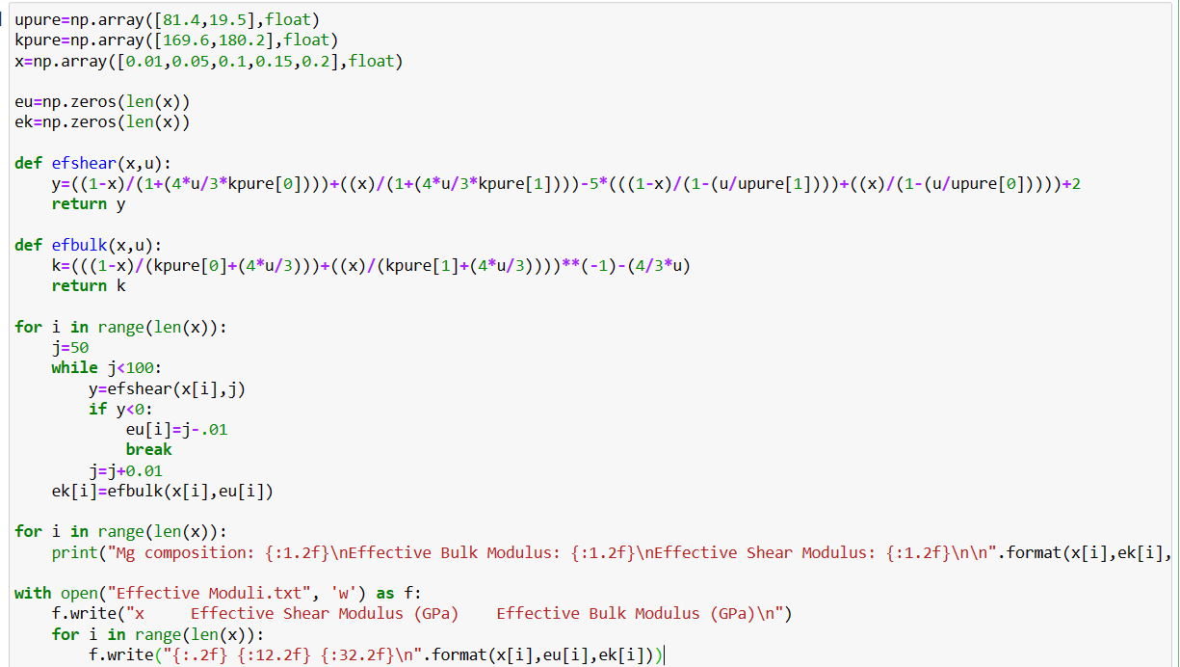

Slide 16
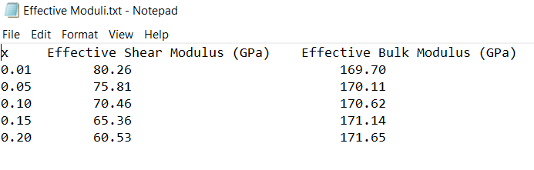
Output in Text file
As Mg increases, moduli become closer to the Mg moduli values.

Slide 17
04
Composition Effects

Slide 18
Composition Effects
Lattice parameter from composition effects calculated using an elasticity inclusion model and size of solute in solvent matrix (Lubarda et al.)
Must be repeated for each composition (x)
Lattice parameter change due to composition effects also calculated
All values in Angstrom

Slide 19




Composition Effects
a₁= LP from literature
R₁= Seitz Atomic radius (BCC Fe)
k= number of atoms per unit lattice cell (2 for BCC)
x= Mg concentration
ϑ= Crystal structure of lattice (1 for BCC)
γ ,γ₁, γ₂= Having to do with bulk and shear moduli of pure components
C= Relation between Seitz radius and γ₂
Lubarda et al.

Slide 20
Outline of Code
For loop over compositons (x)
Make array for a_{lit} , literature values for the LP of BCC Fe and BCC Mg
Make variables for k, ϑ, γ₁, γ₂, R₁, C
Pre-allocate arrays for γ, a_{comp} and Δa_{comp}
Find γ
Calculate a_{comp} and Δa_{comp}
Save a_{comp} and Δa_{comp} values to a text file

Slide 21
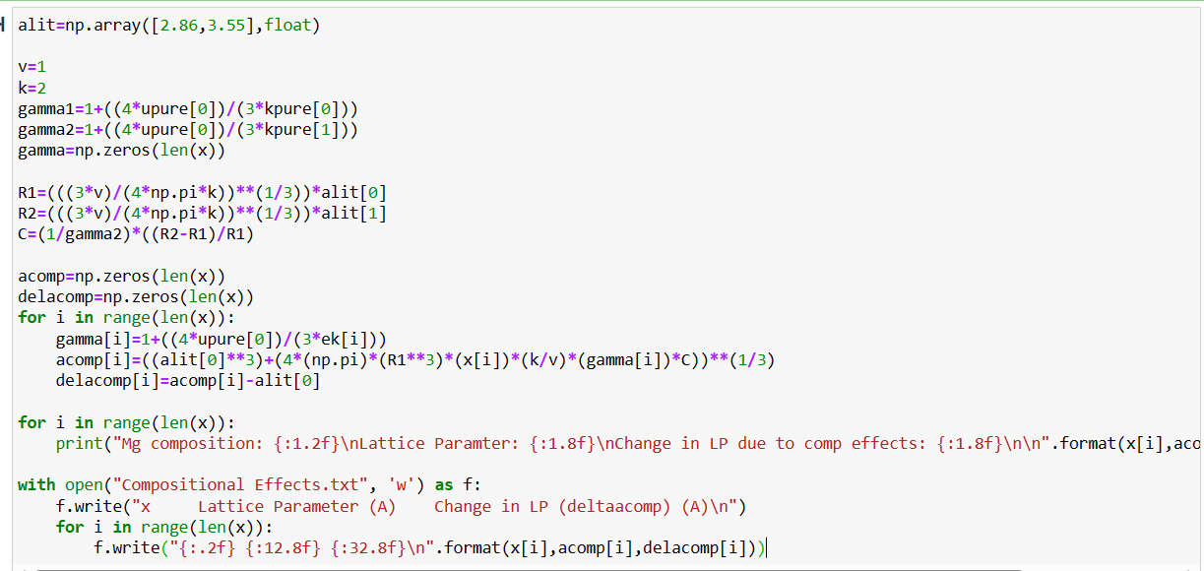

Slide 22
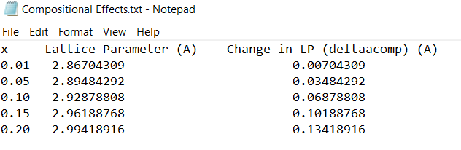
Output in Text file
Increasing Mg causes an increase in the lattice parameter.

Slide 23
05
Grain Size Effects

Slide 24
Interfacial Stress
Interfacial stress leads to hydrostatic compression and this causes the lattice to shrink.
σ_{s}: Interfacial stress (Rane et al.)
D: crystallite size as determined by XRD Reitveld refinement
a₀: LP due to composition effects
K: Effective bulk modulus
Rane et al.

Slide 25
Excess Free Volume
Nanocrystalline materials have highly disordered grain boundaries.
Leads to defects and vacancies and therefore excess free volume.
Rane et al.
a₀: LP due to composition effects
D: crystallite size as determined by XRD Reitveld refinement
ξ: Grain boundary thickness (estimated 1 nm)

Slide 26
Grain Size Effects
Lattice Parameter due to grain size effects is the sum of the interfacial stress and excess free volume.
Δa_{GS} in nanometers.
Must be repeated for each composition (x).

Slide 27
Outline of Code
For loop over compositons (x)
Make variables for σ_{s} and ξ
Make an array for experimental grain size values (d)
Pre-allocate arrays for Δa_{is} , Δa_{EFV} , Δa_{GS} and divide a_{comp} by 10
Calculate Δa_{is}
Calculate Δa_{EFV}
Add Δa_{is} and Δa_{EFV}
Save Δa_{is} , Δa_{EFV} , and Δa_{GS} values to a text file

Slide 28
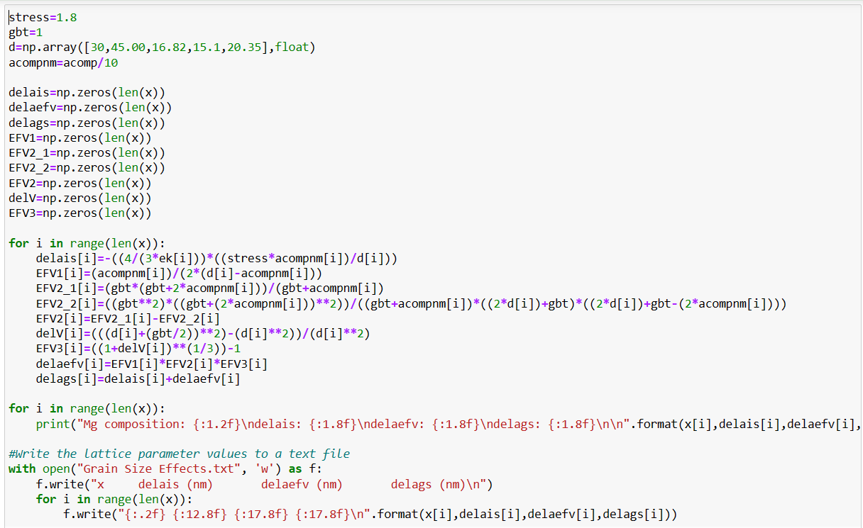

Slide 29
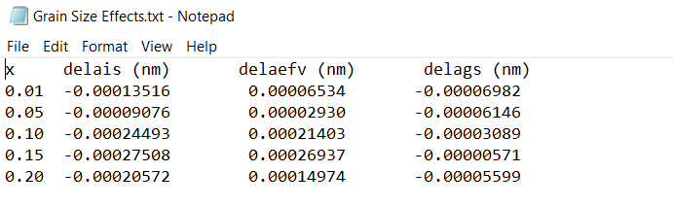
Output in Text file
Interfacial stress shrinks the lattice with increasing Mg while EFV expands it.

Slide 30
06
Grain Boundary Segregation

Slide 31

Grain Boundary Segregation
Lattice Parameter change due to grain boundary segregation is calculated as the difference between the experimental and literature values for BCC Fe LP minus the changes due to the other effects.
Must be repeated for each composition (x)
All values in Angstrom

Slide 32
Outline of Code
For loop over compositons (x)
Make an array for the experimental lattice parameter values, a_{exp}.
Pre-allocate an array for Δa_{GBS}
Calculate Δa_{GBS} by indexing into arrays for Δa_{GS} , Δa_{comp}, a_{lit}, and a_{exp}.
Save Δa_{GS} , Δa_{comp}, Δa_{GBS} , a_{lit}, and a_{exp}. values to a text file

Slide 33
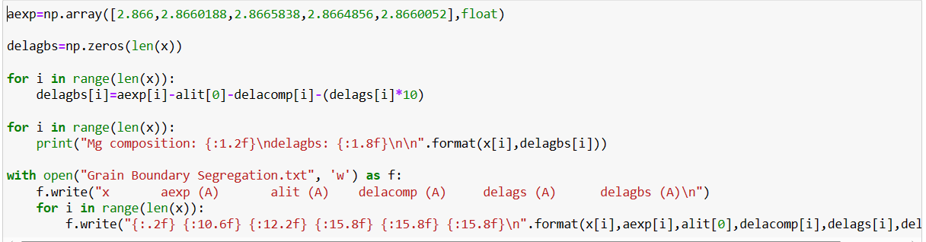

Slide 34
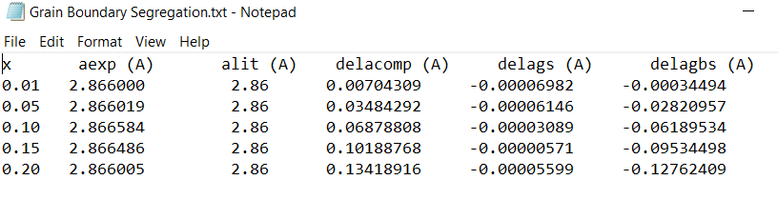
Output in Text file
Increased Mg causes more grain boundary segregation and shrinking lattice parameter.

Slide 35
07
Plotting

Slide 36

Plotting
Lattice Parameter (A) vs Mg Composition (at%) Plot made.
Experimental
Vegard’s Law
Simplified way to account for compositional effects for binary alloys
Composition Effects
Grain Size Effects
Grain Boundary Segregation
Dane et al.

Slide 37
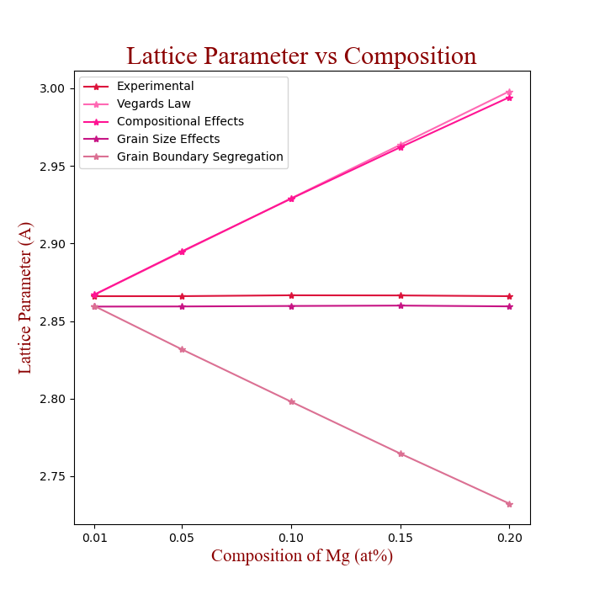
Compositional effects expand the lattice.
Grain boundary segregation shrinks the lattice.

Slide 38
08
Curve Fitting

Slide 39
Curve Fitting
It is desired to find a simplified function for the relationship between Lattice Parameter and Mg composition.
Can be used for quick estimates of the lattice parameter for intermediate compositions.
As seen from plot, should be a linear trend between the 2 parameters.
Linear Regression Model (Least Squared Method) (linregress)
Curve_fit Function with a linear function
Find R² and RMS Error for both methods
Plot the 2 fits and the experimental data to see how it compares.

Slide 40
Outline of Code
Import stats from scipy
Call the linregress function
Print the output equation
Find R² and RMS
Import curve_fit function
Define linear function
Call curve_fit function
Print the output equation
Find R² and RMS
Plot the experimental data and the fitted lines.

Slide 41
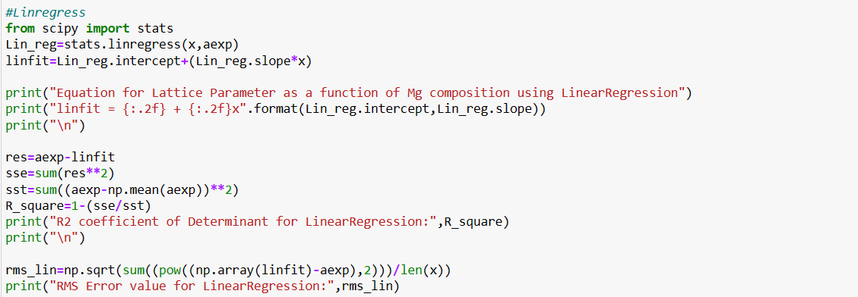
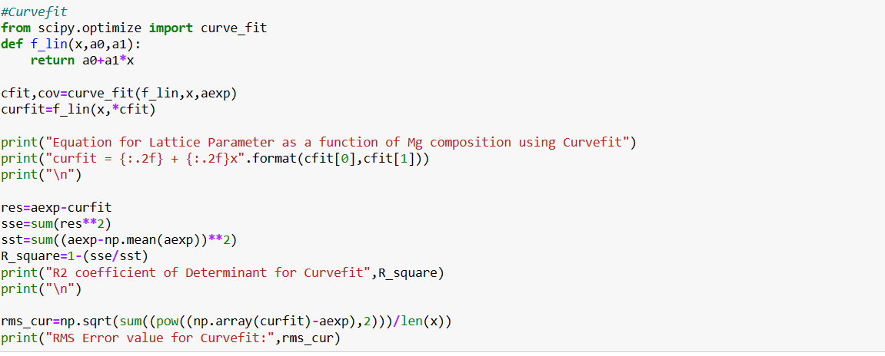

Slide 42
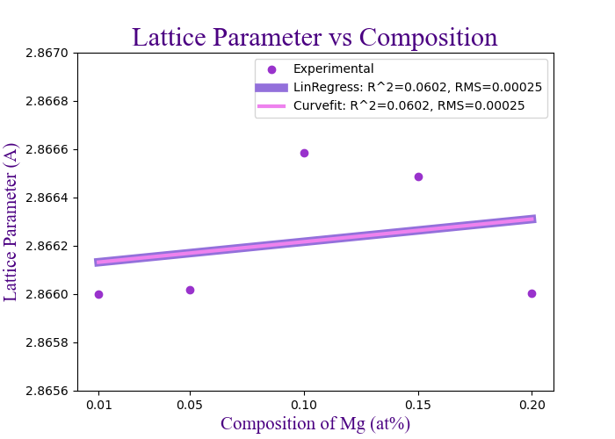
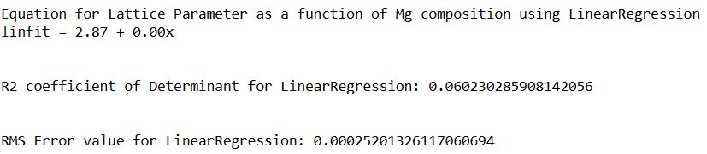
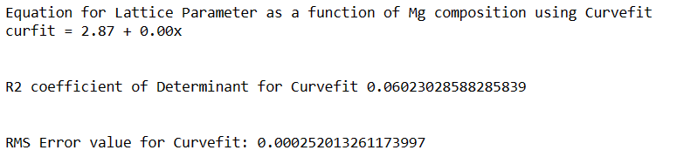

Slide 43
Curve Fitting
Linear function does not seem to be a good fit.
Curvefit function can be used to fit higher order polynomials.
Experimental data should be linear but it is worth trying different types of fits to see the result.
2nd and 3rd order polynomial fits are done
R² and RMS error found.
Fits plotted with experimental data.

Slide 44
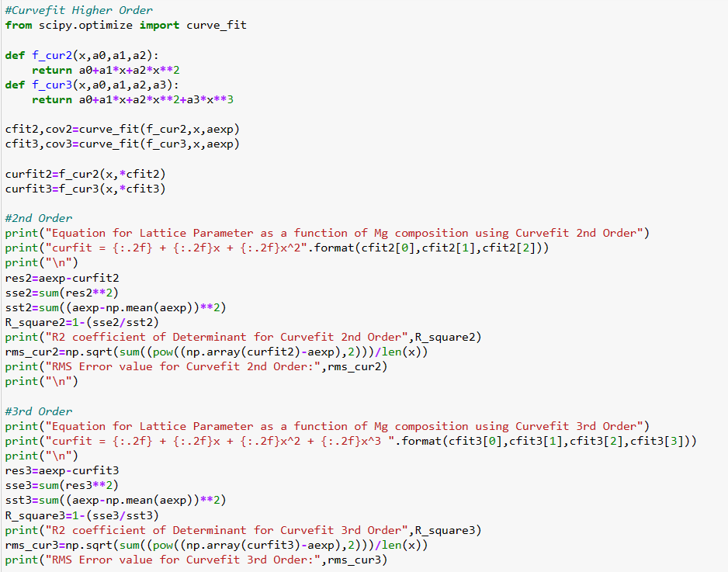

Slide 45
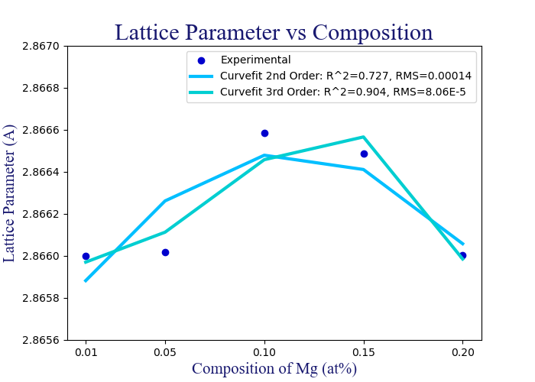
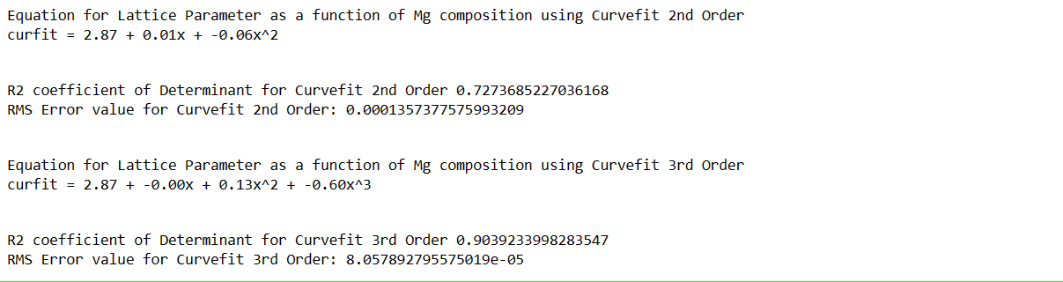

Slide 46
Conclusion and Future Work

Slide 47
Conclusion and Future
Pyhton3 code was used to get the lattice parameter changes due to changing Mg compostions in FeMg ODS alloys.
Several physical phenomena make contributions to the changes.
Some expand the lattice, some cause it to shrink.
Linear regression and curve fitting (1st, 2nd, 3rd order) were used to get a simplified trend of LP and composition.
Once more accurate experimental data is gathered, the fits will be better.
Python code allowed for quicker calculations with no errors and publication ready plots.
Future work includes better experimental data and creating a data class/library with functions for the calculations.

Slide 48
Sources
“MP-13: Fe (Cubic, Im-3M, 229).” Materials Project, https://materialsproject.org/materials/mp-13.
“MP-13: Fe (Cubic, Im-3M, 229).” Materials Project, https://materialsproject.org/materials/mp-13.
Codoluto, Daniel. “Crystal Structure Overview.” Study.com, https://study.com/learn/lesson/cubic-unit-cell-lattice-parameter-crystal-structure.html.
Lubarda, V.A. “On the Effective Lattice Parameter of Binary Alloys.” Mechanics of Materials, vol. 35, no. 1-2, 2003, pp. 53–68., https://doi.org/10.1016/s0167-6636(02)00196-5.
Rane, Gayatri Koyar, et al. “Non-Monotonic Lattice Parameter Variation with Crystallite Size in Nanocrystalline Solids.” Acta Materialia, vol. 61, no. 12, 2013, pp. 4524–4533., https://doi.org/10.1016/j.actamat.2013.04.021.
Denton, A. R., and N. W. Ashcroft. “Vegard’s Law.” Physical Review A, vol. 43, no. 6, 1991, pp. 3161–3164., https://doi.org/10.1103/physreva.43.3161.

Slide 49
Questions?

